Slide 1
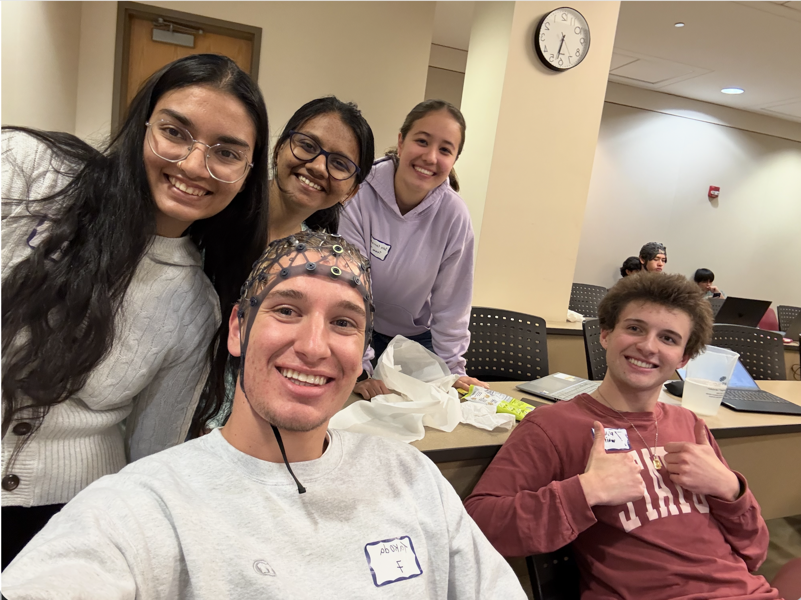
Hands-Free Viewer
NEUROTECH HACKATHON
Team 7
Media for people with quadriplegia, controlled by gaze and a jaw clench through EEG.
Sola Corrado, Bhoomi Mehta, Takoda Moore, Mahek Shah, Fisher White
Notes:
Team 7, ANT Neuro track. The Hands-Free Viewer lets a person with quadriplegia read a PDF, listen to audio and watch video without using their hands. Looking at a glowing arrow moves through content; clenching the jaw acts. Both signals come from the ANT Neuro eego headset.

Slide 2
Built for people with quadriplegia
THE MARKET
305,000
WHY THIS MARKET
Eyes and jaw still work
people living with a spinal cord injury in the US
Their nerves leave the brainstem, so a neck injury usually spares them
6 in 10
new US spinal cord injuries since 2015 are quadriplegia
Media today still assumes hands
15.4M
Scrolling, pausing and skipping all need a hand
people living with a spinal cord injury worldwide, 2021
Independence
Each task done hands-free is one less request to a caregiver.
Sources: NSCISC Facts and Figures 2024; WHO, 2024.
02
Notes:
We built this for people with quadriplegia. About 305,000 people in the US live with a spinal cord injury, and about six in ten new injuries since 2015 are tetraplegia, the clinical term for quadriplegia. Worldwide, 15.4 million people were living with a spinal cord injury in 2021. A neck injury removes hand function, but the eyes and jaw run on cranial nerves above the spinal cord, so they usually keep working. Those are exactly the two signals we use.

Slide 3
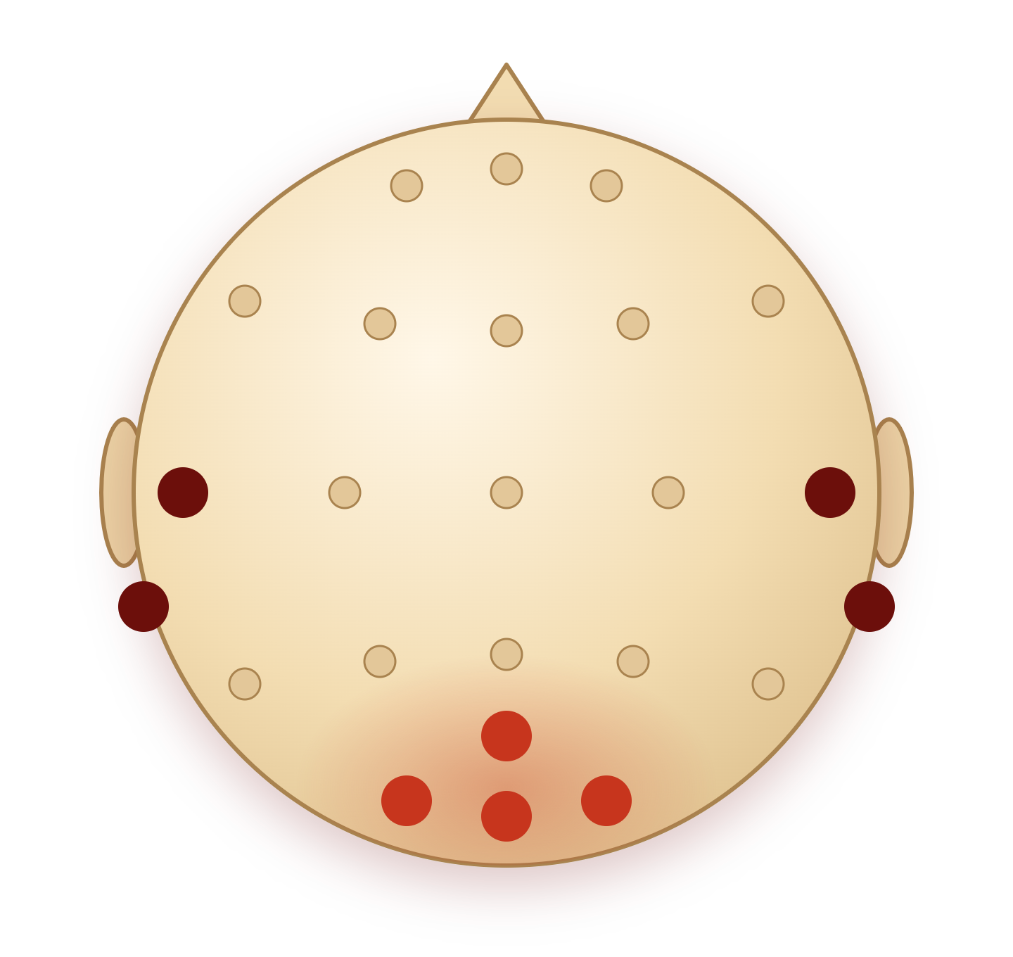



Eight of 24 electrodes carry the commands
THE SIGNALS
Gaze: O1, Oz, O2, Pz
T7
T8
Arrows flicker at 12–15 Hz; the visual cortex follows the one in view.
M1
M2
Jaw: T7, T8, M1, M2
Pz
A clench lifts 30–100 Hz muscle power above the resting level.
Other 16 channels
O1
Oz
O2
Recorded, not used by either detector. Top view, nose up.
03
Notes:
Both signals come from the eyes and jaw, which quadriplegia leaves working. The headset records 24 channels; eight carry commands. Each arrow flickers at its own rate between 12 and 15 Hz, and the visual cortex at the back of the head follows the one the wearer looks at; the app checks for that rhythm every quarter second. A jaw clench lifts muscle activity at the temples well above the wearer’s resting level, and that registers as a clench.

Slide 4

The viewer in use
DEMO
PDF
Gaze arrows scroll and turn pages; a held clench zooms.
Audio
A double clench plays or pauses; a single clench goes back 15 s.
Video
A clench plays or pauses; gaze arrows skip 15 s.
Contains flickering light at 12–15 Hz.
Notes:
And now we have a video demo of our product in use. This video contains flashing lights so viewer discretion is advised for anyone with photosensitivity towards flashing lights.
Play the one-minute video. It shows the PDF, audio and video tabs controlled by gaze and jaw alone. [Adjust these notes and the three rows to match the final video.]

Slide 5
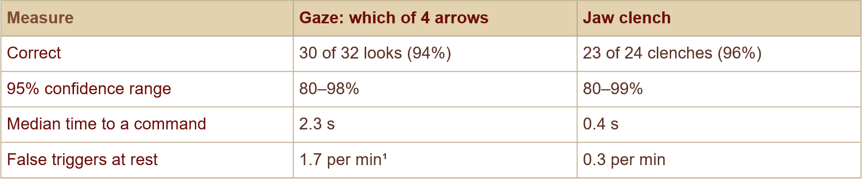
Tested on 1 wearer over two days
RESULTS
05
Notes:
We tested on two wearers across four sessions over two days. For wearer 1, the four flicker rates the viewer uses scored 84 to 100 percent and the jaw clench 92 to 100 percent, including the next morning on a different laptop. Wearer 2 scored 94 to 100 percent at 11 to 15 hertz; 9 hertz was weaker, near the natural 10 hertz alpha rhythm, which is why rates close to 10 hertz are a risk. Streaming wearer 1’s recording into the app, all 12 arrow commands and all 6 clenches registered, with no wrong arrows, in about 1 to 1.5 seconds per look.

Slide 6
The build against the five criteria
JUDGING CRITERIA
Practicality
Uses the eye and jaw control that quadriplegia leaves intact; runs on a laptop
Creativity
Four signals - one headset: a brain response steers, a muscle signal acts, and soft glows replace flashing boxes.
Technical difficulty
Real-time SSVEP interpretation; 24-channel, 500 Hz stream, a jaw detector with a personal baseline, and a crosstalk guard.
Execution
Desktop and web apps, run live on the ANT Neuro eego
Scalability
Consumer experience; hardware, software, service
NEXT STEPS
Consumer ease of use
Per-wearer models
User friendly hardware
Auto-calibration
Code: github.com/solacorrado/eeg-interpreter
06
Notes:
Against the five criteria. Practicality: it relies on the eye and jaw control that quadriplegia leaves intact and runs on a laptop. Creativity: one headset gives two signals, a brain response to steer and a muscle signal to act. Technical difficulty: real-time correlation analysis on a 24-channel, 500 Hz stream, a jaw detector tuned to each wearer, and a guard that stops one signal confusing the other. Execution: both apps run live on the eego, as the video and results show. Scalability: any app can map the same two signals, and the software reads any LSL EEG stream. Next steps, on the band below: automatic calibration from a short recording, filter-bank CCA for a stronger gaze score without training, per-wearer models for shorter gaze windows and fewer false clenches, and fewer electrodes toward a lighter wearable.

